Slide 1
CSS

Slide 2
Topics
Syntax
CSS selectors
Box Model
Inline and Block elements.
Display
Pseudo classes
float
CSS Image gallery
Navigation bars
Adding fonts from Google fonts – Roberto, Open Sans
Media Queries.

Slide 3
CSS selectors
The CSS element Selector
The CSS id Selector
The CSS class Selector
p { text-align: center; color: red; }
#para1 { text-align: center; color: red; }
.center { text-align: center; color: red; }

Slide 4
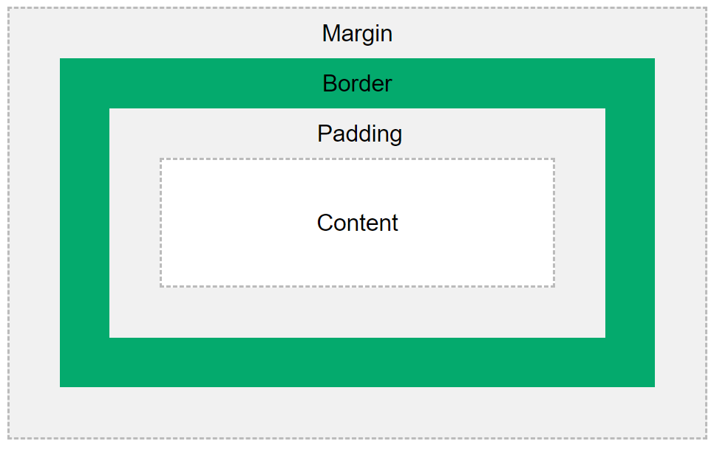
The CSS Box Model

Slide 5
div { width: 300px; border: 15px solid green; padding: 50px; margin: 20px; }

Slide 6
Inline and Block elements
Some elements are inline by default, like <span>, <a>, <i>, and <img>.

Slide 7
inline
Displays an element as an inline element. Any height and width properties will have no effect.
span
a
Img
em
strong
i
small
.inline-element {
display: inline;
width: 1000px; /* ❌ won't have any effect */
height: 1000px; /* ❌ won't have any effect */
}

Slide 8
inline-block
Displays an element as an inline-level block container. You CAN set height and width values.
.inline-block-element {
display: inline-block;
width: 1000px; /* ✅ yes, it will work */
height: 1000px; /* ✅ yes, it will work */
}

Slide 9
block
Check the length of the string
It starts on a new line and takes up the whole width
div
h1
p
li
section

Slide 10
